Slide 1




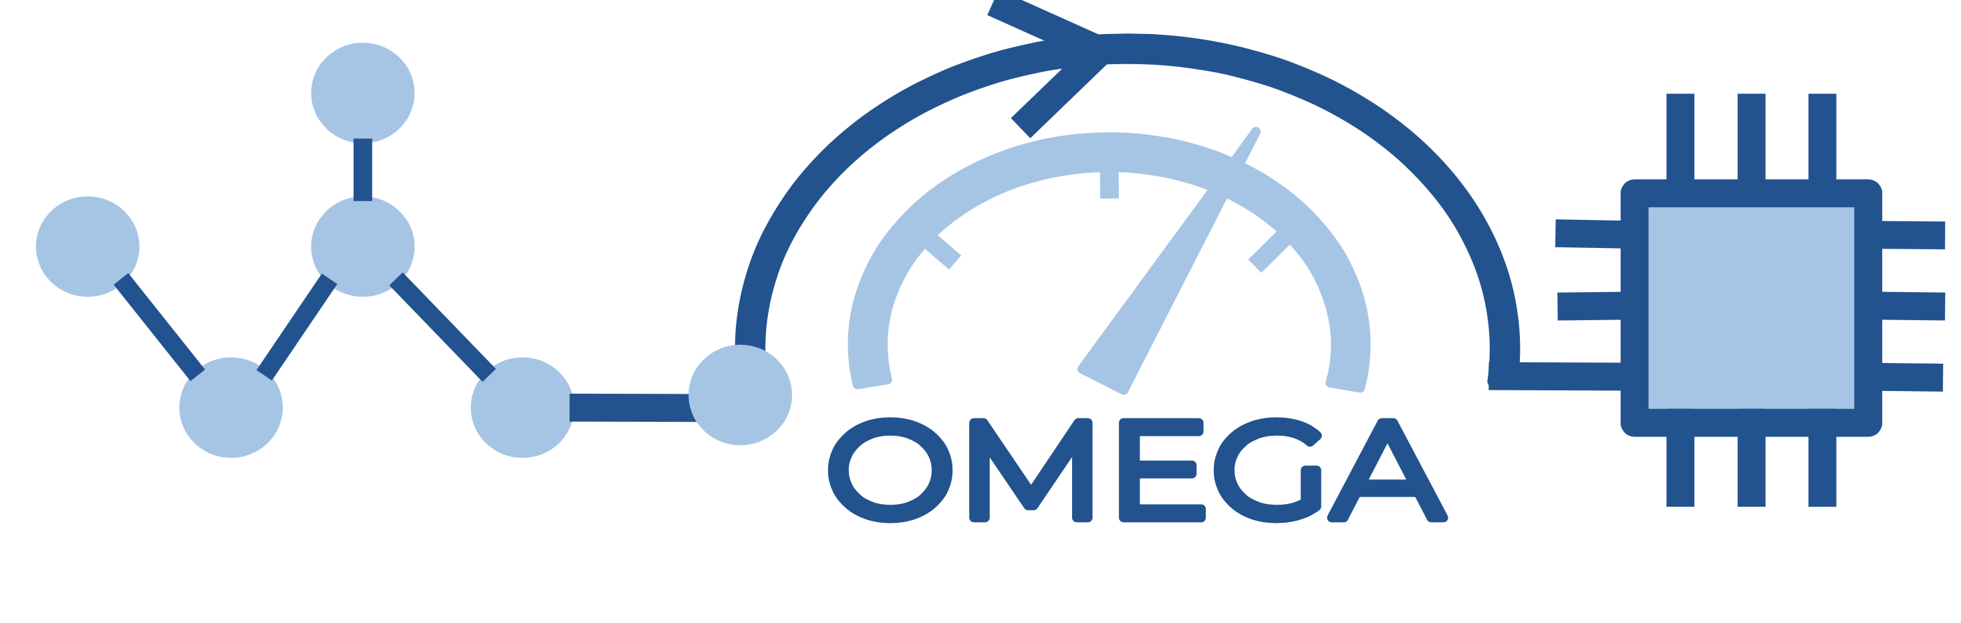
WELCOME TO STONNE TUTORIAL!
Enabling Detailed Cycle-Level Simulation of AI and HPC Applications with Detailed Memory Hierarchy using STONNE, OMEGA and SST-STONNE
https://stonne-simulator.github.io/ASPLOSTUT.html

Slide 2
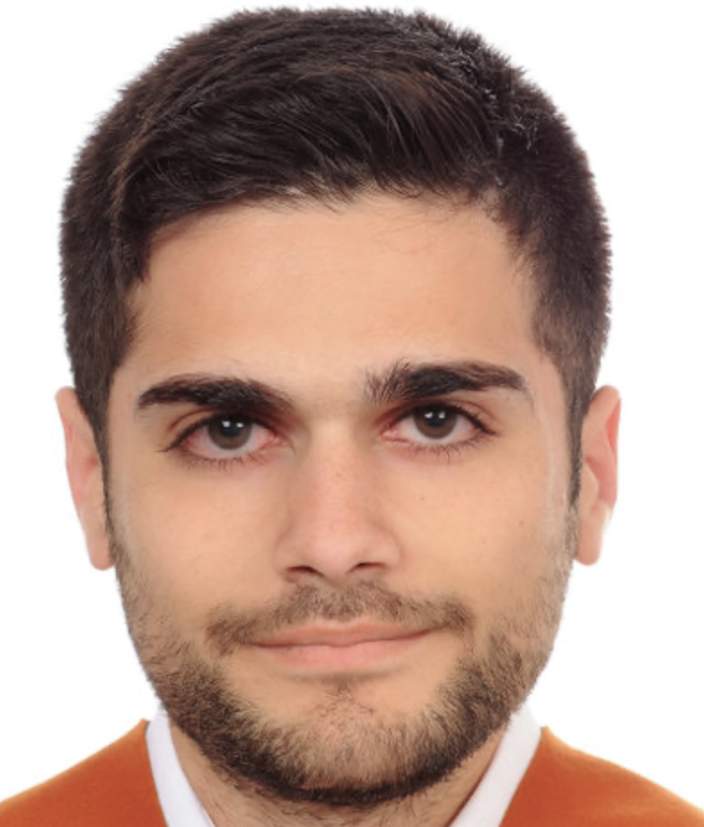
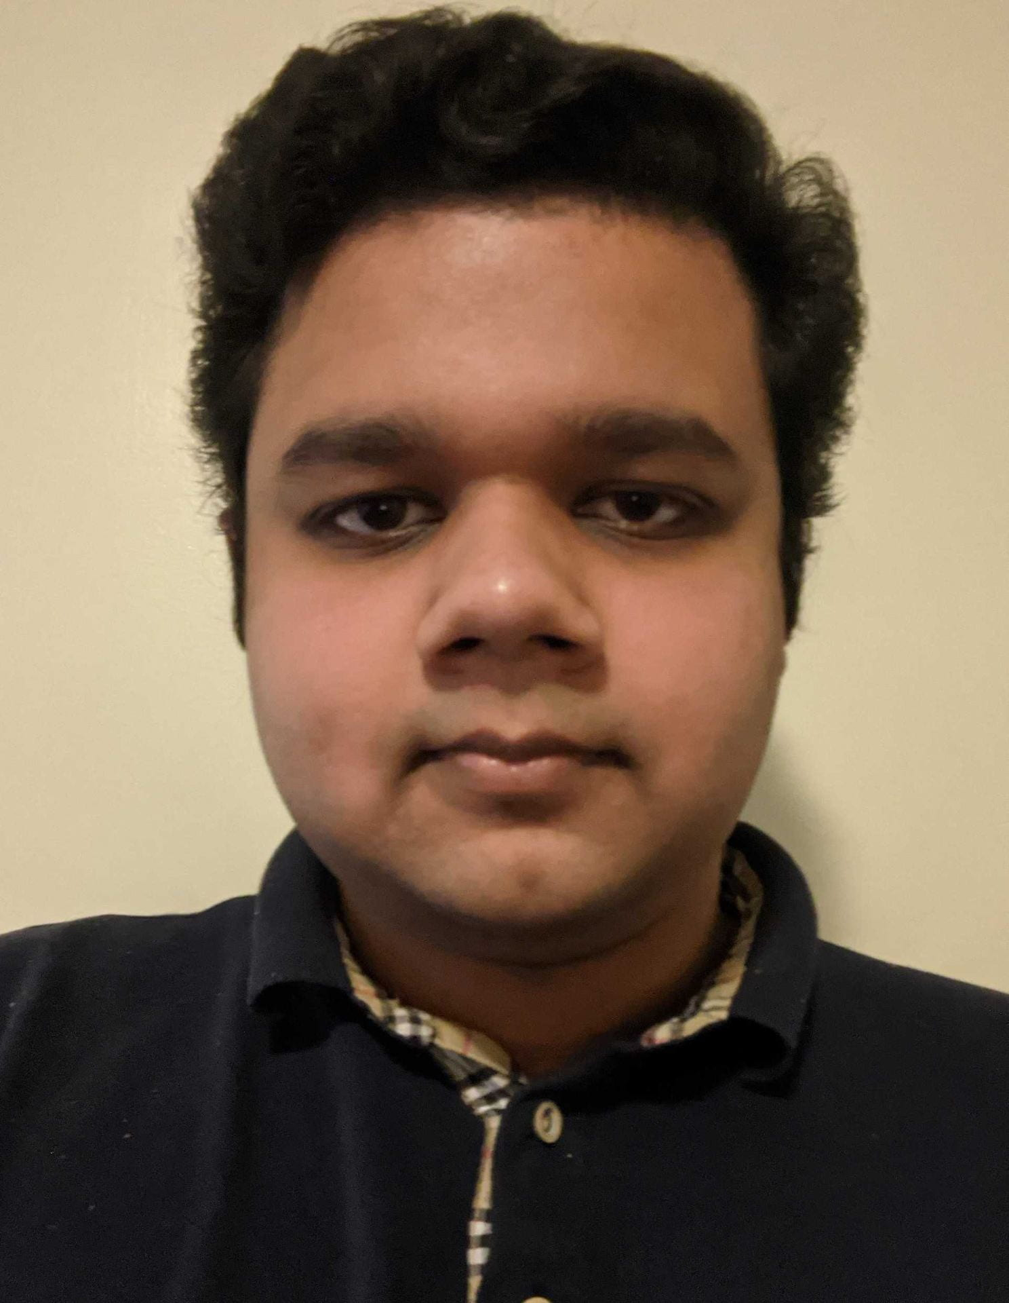
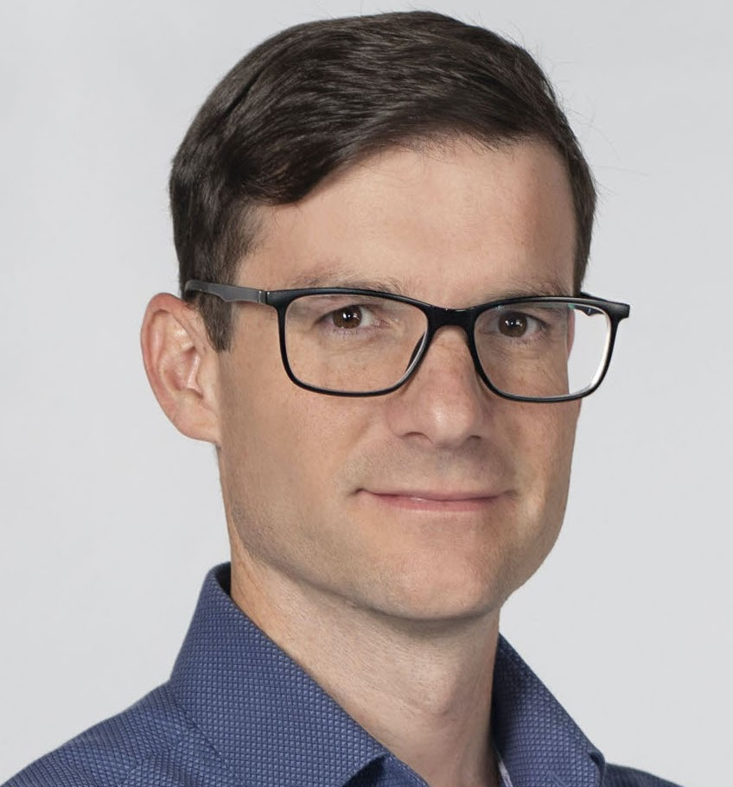
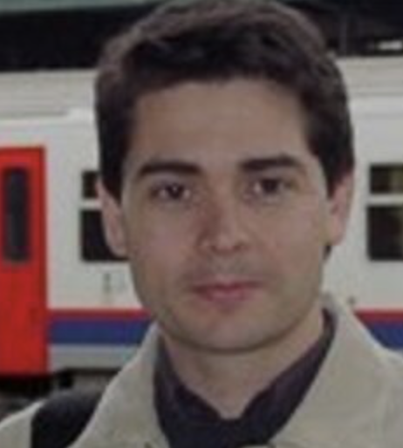
Organizers
Francisco Munoz-Martinez
Postdoc Researcher
University of Murcia
francisco.munoz2@um.es
Raveesh Garg
Ph.D Student
Georgia Institute of Technology
raveesh.g@gatech.edu
José L. Abellán
Ramón y Cajal Researcher
University of Murcia
jlabellan@um.es
Manuel E. Acacio
Full Professor
University of Murcia
meacacio@um.es
Tushar Krishna
Associate Professor, School of ECE
Georgia Institute of Technology
tushar@ece.gatech.edu
STONNE Tutorial @ASPLOS 2023

Slide 3
Agenda
Time (PDT) | Topic | Presenter
1:40 – 2:00 | Flexible Accelerators | José L. Abellán
2:00 – 2:20 | Cycle accurate simulation and Overview of STONNE | José L. Abellán
2:20 – 3:20 | (Hands-on) STONNE | Francisco Muñoz-Martínez
3:20 – 3:40 | Coffee Break
3:40 – 4:10 | (Hands-on) SST-STONNE | Francisco Muñoz-Martínez
4:10 – 4:40 | (Hands-on) OMEGA | Raveesh Garg
4:40 – 5:00 | Roadmap and Concluding Remarks | Tushar Krishna
https://stonne-simulator.github.io/ASPLOSTUT.html

Slide 4



Acknowledgements
Co-Design Center for Artificial Intelligence-Focused Architectures and Algorithms Funded By

Slide 5
If you want to reproduce the experiments during the session, please type the next docker command on your machine (12 GB disk space required):
docker run –it stonnesimulator/stonne-simulators
git clone https://github.com/stonne-simulator/tutorials (inside docker)

